Slide 1
Fingerprint Authentication System In Banking Transaction
GESTS International Transactions on
Computer Science and Engineering
http://www.gests.org

Slide 2
Content
Introduction
Fingerprint and Features
Fingerprint Authentication System (FAS)
Image Enhancement
Feature extraction + Post processing
Authentication
Experimental Result
Conclusion

Slide 3
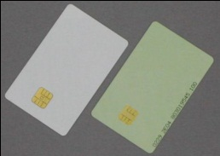
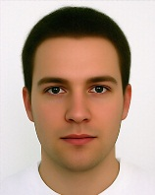
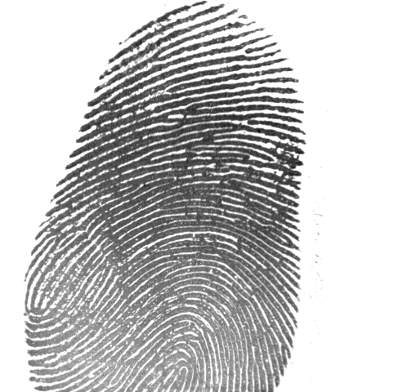
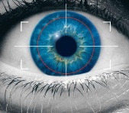
Introduction
Security on Banking Transaction
Key:
Something you have
Something you know
Something you are
Biometric Authentication System: iris, fingerprint, face, voice,palm, …
123456789

Slide 4
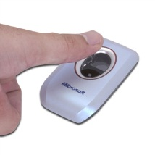
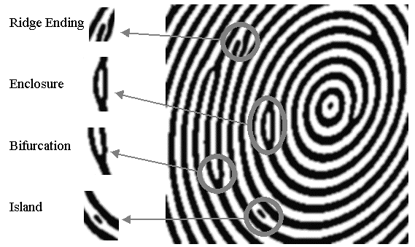
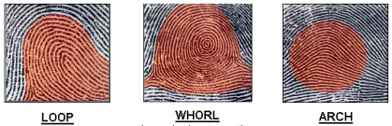
Fingerprint
uniqueness
Immutable
Not easy to fake
Fingerprint minutiae
Fingerprint types

Slide 5
Fingerprint Authentication System
Image Enhancement
Feature extraction + Post processing
Authentication

Slide 6
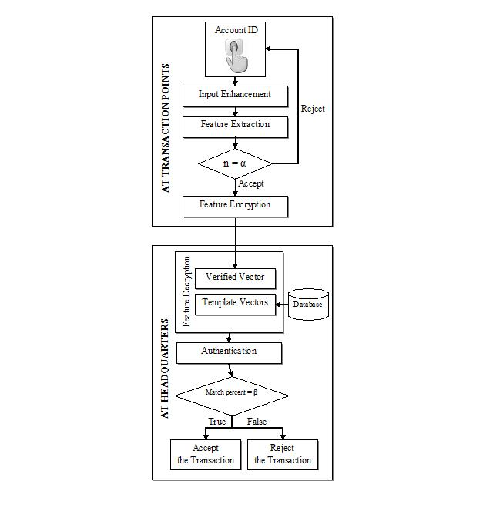
Operating Model of FAS in Banking Transaction

Slide 7
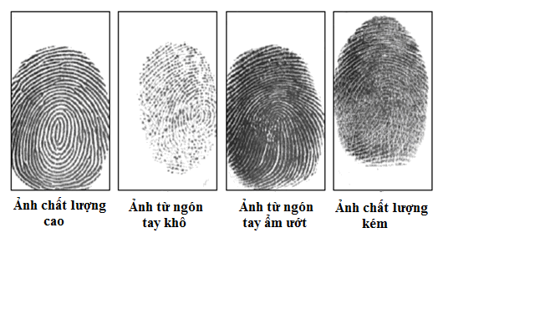
Image Enhancement
(a)
(b)
Figure 1: Samples of fingerprint
Good Quality Image
Bad Quality Image: dry fingerprint, wet fingerprint, bad condition, …

Slide 8
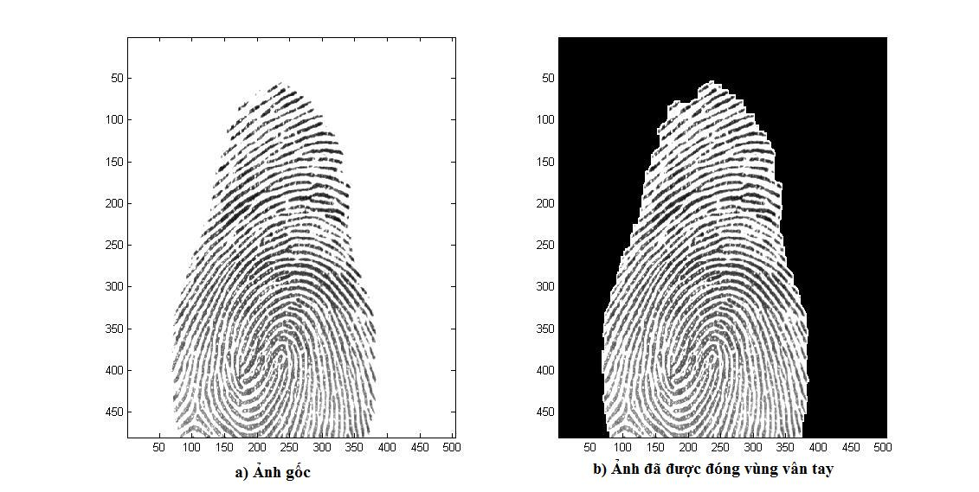
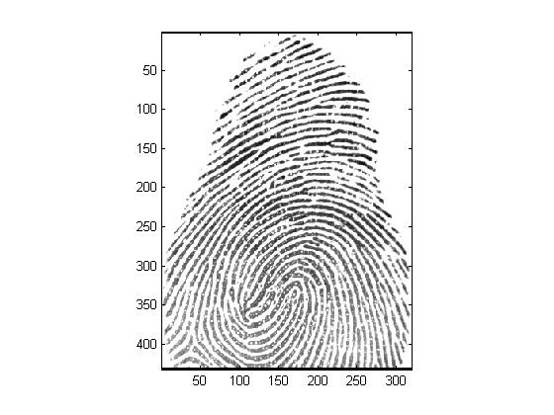
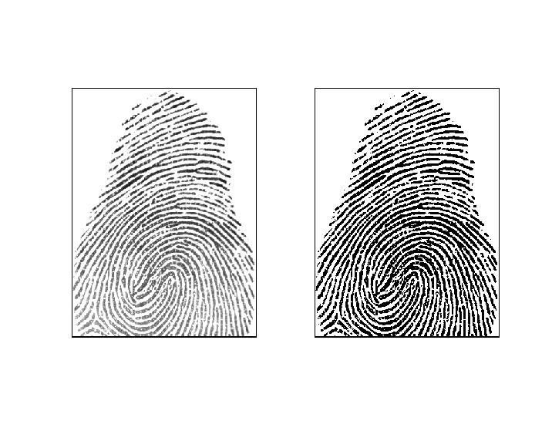
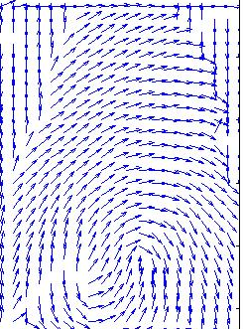
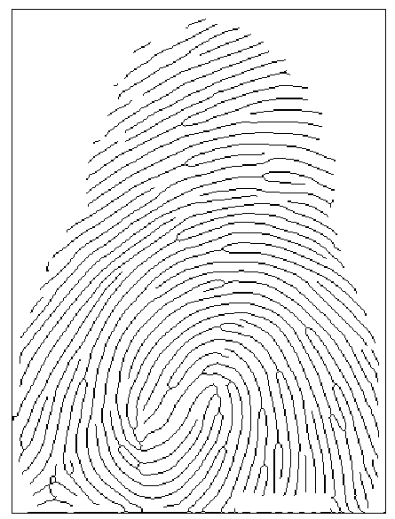
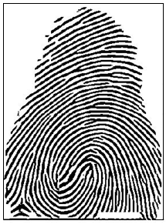
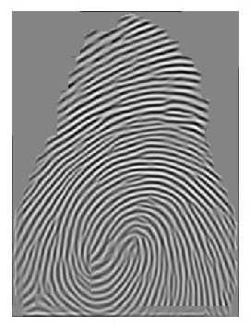
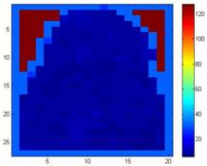
Orientation Estimation
Segmentation
Normalization
Frequency Estimation
Image Enhancement diagram
Thinning
Binarization
Gabor Filter

Slide 9
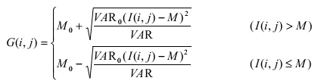
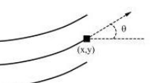
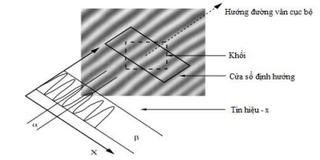
Segmentation: enclose the interest region of the fingerprint image using some morphological methods.
Normalization:
Orientation Image Estimation
Frequency Image Estimation

Slide 10


Filter – Gabor Filter
Binarization
Thinning

Slide 11
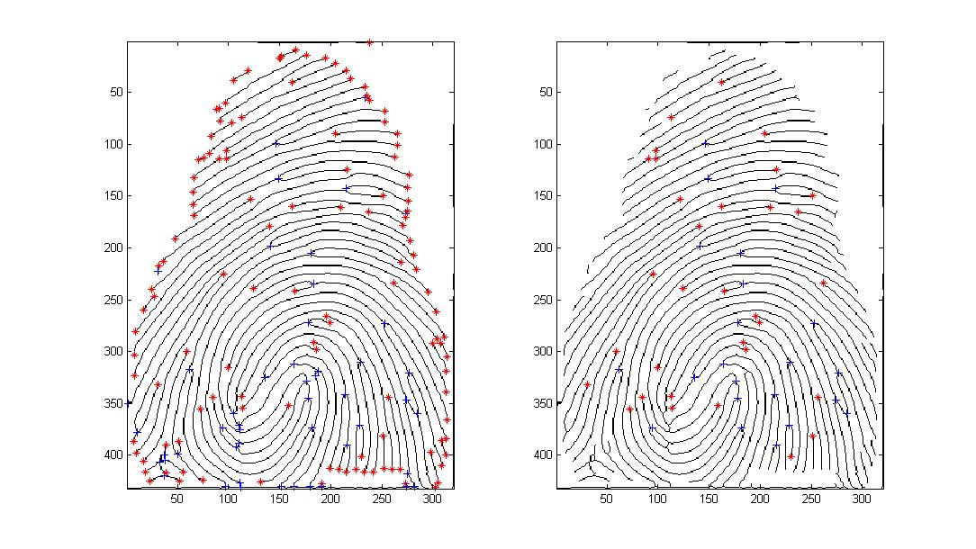
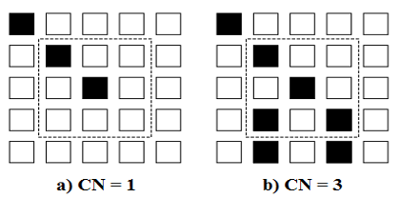
Feature Extraction
Crossing number method
Minutiae:
Type: ridge ending, ridge bifurcation
Location
Orientation

Slide 12
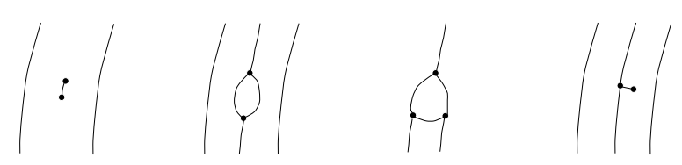
Post-processing
Figure 1: False minutiae
Figure 1: Fingerprint minutiae before and after removing false minutiae

Slide 13
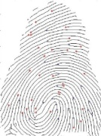
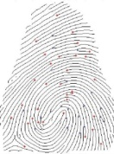
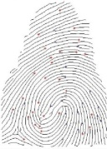
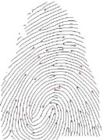
Authentication
Database
Feature vector
Feature alignment
Matching
p>T
Reject
Accept

Slide 14
Feature Alignment
Where,
: the original coordinate.
: the new coordinate.
: transformation parameters.

Slide 15

Matching
Feature vector
$t_{1}(l_{1},x_{1},y_{1},θ_{1})$ and $t_{2}(l_{2},x_{2},y_{2},θ_{2})$
Matching:
Match

Slide 16

AES in FAS
Advanced Encryption Standard (AES)
Encrypt data (feature vector) at the ATM before sending to FAS at the bank.
Refer thesis of Dr. Tran Minh Triet
key(128 BIT)
Feature Vector
AES
Encrypted data
Encrypt
Decrypt

Slide 17
Experimental Result
Database | Accuracy (%) | FAR (%) | FRR (%) | Processing Time(s)
T = 0.3
DB_FP | 100 | 0.00 | 8.69 | 2.8546
UareU | 95.31 | 4.69 | 26.56 | 1.6759
T = 0.35
DB_FP | 93.48 | 6.52 | 2.17 | 2.8565
UareU | 89.06 | 10.94 | 7.81 | 1.6701
T = 0.4
DB_FP | 86.96 | 13.04% | 0.00% | 2.8552
UareU | 73.44 | 26.56 | 6.52% | 1.6690
T = 0.45
DB_FP | 86.96 | 13.04 | 0.00 | 2.8533
UareU | 68.75 | 31.25 | 1.56 | 1.6685
T = 0.5
DB_FP | 86.96 | 13.04 | 0.00 | 2.8533
UareU | 65.63 | 34.38 | 0.00 | 1.6702
T = 0.55
DB_FP | 69.57 | 30.43 | 0.00 | 2.8114
UareU | 65.63 | 34.38 | 0.00 | 1.6687

Slide 18
Conclusion
Strong point:
Removing almost false minutiae and retrieval disconnect ridge
Extract almost feature on fingerprint
Speed Processing
Limitation
Choosing threshold depend on database
Experimental Result base the database from the internet.

Slide 19
Reference
[1] Davide Maltoni, Dario Maio, Anil K. Jain and Salil Prabhakar, “Handbook of Fingerprint Recognition”, SpringerLink, 2009.
[2] A. K. Jain, L. Hong, and R. Bolle, “On-line fingerprint verification,” IEEE Trans. on Pattern Anal. Mach. Intell., Vol. 19, pp. 302-314, 1997.
[3] V. Conti, G. Milici, S. Vitabile and F. Sorbello, “Morphological Enhancement and Triangular Matching for Fingerprint Recognition”, proc. of International Joint Conferences on Computer, Information, and Systems Sciences, and Engineering, (CIS2E 07), e-conference on December 3 - 12, 2007.
[4] Marcelo de Almeida Oliveira and Neucimar Jeronimo Leite, “Reconnection of Fingerprint Ridges Based on Morphological Operators and Multiscale Directional Information”, Proceedings of the Computer Graphics and Image Processing, XVII Brazilian Symposium, p.122-129, 2004.
[5] Jiangang Cheng and Jie Tian, “Fingerprint enhancement with dyadic scale-space”, Pattern Recognition Letters, Vol. 25, pp. 1273-1284, 2004.
[6] Lin Hong, Yifei Wan and Anil K. Jain, “Fingerprint Image Enhancement: Algorithm and performance algorithm”, IEEE Transactions on Pattern Analysis and Machine Intelligence, vol. 20, no. 8, pp. 777–789, 1998.
[7] Jianwei Yang, Lifeng Liu, Tianzi Jiang and Yong Fan, “A Modified Gabor Filter Design Method For Fingerprint Image Enhancement”, Pattern Recognition Letters, vol. 24, issue 12, pp. 1805-1817, 2003.
[8] A. Farina, Z.M. Kovács-Vajna, and A. Leone, “Fingerprint minutiae extraction from skeletonized binary images”, Pattern Recognition, pp. 877-889, 1999.
[9] J. C. Amengual, A. Juan, J. C. Prez, F. Prat, S. Sez, and J. M. Vilar, “Real-time minutiae extraction in fingerprint images”, Proc. of the 6th Int. Conf. on Image Processing and its Applications, pp. 871–875, 1997.
[10] DarioMaio and David Maltoni, “Direct gray scale minutae detection in fingerprints”, IEEE Transaction on Pattern Recognition and Maching Intell., Vol. 19, No. 1, 1997.
[11] Wahab, A., Tan, E. C. and Jonatan, A. “Direct Gray-Scale Minutiae Extraction”, Biometric Authentication: First International Conference, ICBA 2004, Hong Kong, China, 2004.
[12] D.P. Mital, Eam Khwang Teoh, “An automated matching technique for fingerprint identification”, Proceedings of 22nd International Conference on Industrial Electronics, Control, and Instrumentation, vol.2, pp. 806 - 811 , 1996.
[13] He, Y., J. Tian, X. Luo, and T. Zhang, “Image enhancement and minutiae matching in fingerprint verification”, Pattern Recognition Letters, vol.24, pp.1349-1360, 2003.
[14] Yuliang He, Jie Tian, Liang Li, Hong Chen, Xin Yang, “Fingerprint matching based on global comprehensive similarity”, Pattern Analysis and Machine Intelligence, IEEE Transactions on vol. 28, pp. 850-862, 2006.
[15] M. Tico, and P. Kuosmanen, “An algorithm for fingerprint image postprocessing”, In Proceedings of the Thirty-Fourth Asilomar Conference on Signals, Systems and Computers, vol. 2, pp. 1735–1739, 2000.
[16] Tran Minh Triet, “Research and develop information security methods based on AES”, PhD thesis, Vietnamese language.
[17] Jeremy Kubica, Joseph Masiero, Andrew W. Moore, Robert Jedicke, and Andrew Connolly, “Variable KD-Tree Algorithms for Spatial Pattern Search and Discovery”, Neural Information Processing Systems, NIPS 2005, Vancouver, British Columbia, Canada, 2005.
[18] C. Arcelli, G. Baja, “A width-independent fast thinning algorithm”, IEEE Trans., Pattern Analysis and Machine Intelligence, pp. 463-474, 1985.
[Database]: http://ai.pku.edu.cn/biometrics2007/fingerprintlib/

Slide 20
Thank you for your attention

